Slide 1

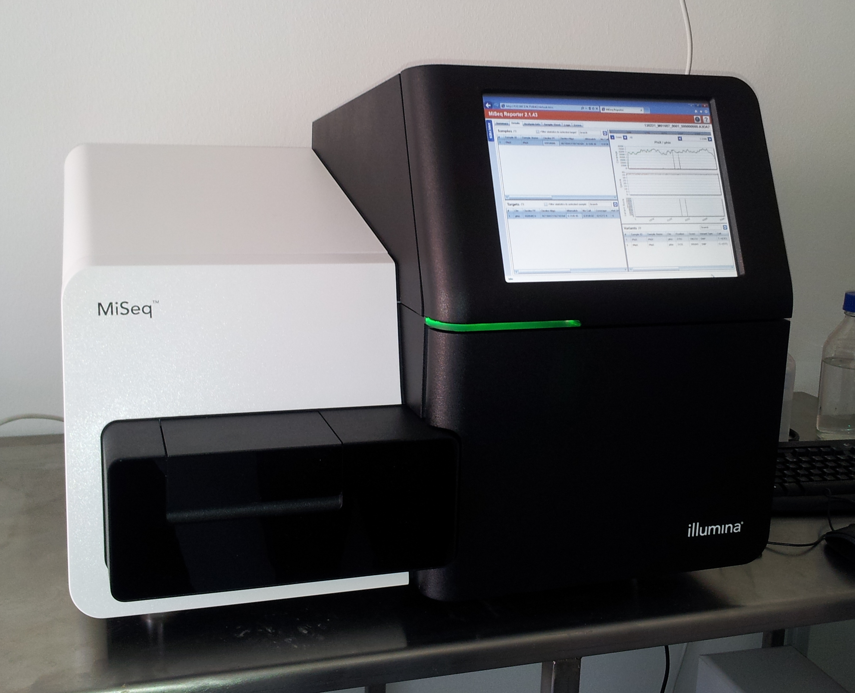
Interpret
Variant Call
Cleaned SAM/BAM file
VCF
1
2
3
Cleanup
SAM/BAM file
Pooled Genomic Library
Reference Seq
.fasta file
Demultiplex
@machine
ATATATAATA <DNA Seq>
+
JJJJJJJ <Phred Scores>
.bcl file
.fastq file
Illumina Sequencing
Wikicommons.com

